Slide 1
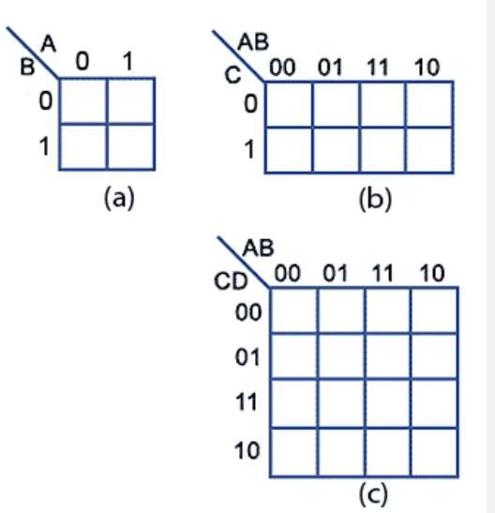
Computer System Architecture COMP201TH
Lecture-4
Karnaugh Maps (K-Map)
K Map:
  Karnaugh map is a method of simplifying Boolean algebra expressions.
  It is actually a truth table in another form.
  It offers a graphical method of reducing a digital circuit to its minimum number of gates.
  Karnaugh maps can be used on small circuits having 2 to 3 inputs as an alternative to Boolean algebra and on more complex circuits having up to 6 inputs; it can provide quicker and simpler minimisation than Boolean algebra.
Fig. : Representation of K-map for 2,3 and 4 variables respectively
Constructing K-maps:
  The shape and size of the map is dependent on the number of binary inputs in the circuit to be analysed.
  2 input circuits with inputs A and B require maps with 2² = 4cells.
  n input circuit will require map with 2^{n} cells.

Slide 2
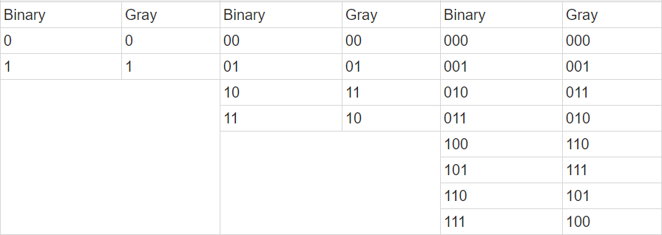
In K maps, the cells are ordered in Gray Code and each cell position represents on combination of input conditions while each cell value represents the corresponding output value.
  Gray code is an ordering of the binary number system such that two successive values differ in only one bit. E.g. the
representation of the (1)10 in binary would normally be 01 and (2)10 would be 10.
  In Gray code, these values are represented as 01 and 11,
respectively.
Fig.: Corresponding Gray codes of Binary numbers
Example of K-Map:
o Simplify A + A` B by use of Karnaugh Map.
f = A+A`B → minterm expression → A`=0 and A=1.
In the expression, first see first term is A, here we will take value of B as both 0 and 1.
Remember, while using K-map if one variable is not specified then we should consider its value both 0 and 1.
e.g. if f = AB +AB`C+A`BC`
here in the first term AB value of C is not specified, so when computing for K map, we will consider value of C as both 0 and 1.

Slide 3
K map for two variable is:
A
0
B
0
1
1
Now, K-map for f = A + A`B will be:
A
0
B
0
1
 | 1
1 | 1
1
In K-map, we will put 1 in the cell where in value of A and B are specified in the Boolean expression i.e. f = A + A`B -> its in minterm expression,
So f = 1 + 01.
Now, as said earlier: In the expression, first see first term is A, here we will take value of B as both 0 and 1.
So, for the given Boolean expression we will take first term as 10 and 11 as value of B is not given so we are considering it both 0 and 1.
Now see, we have put 1 in the cell where cell positions are 10, 11 and 01.
Next step is: we will group adjacent 1’s and choose common between them from their cell positions.
A
B
0 1
1
0
1
1
1
1
1

Slide 4
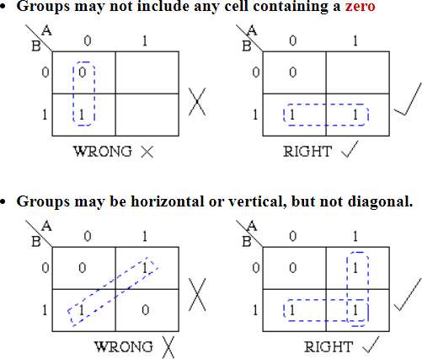
Now , first group (vertically): 01
11
Common is 1 which is B Now, second group (horizontally): 10
11
Common is 1 which is A. So, the solution is A+B.
Rules for simplifying Boolean expressions using K Maps ^{[1, 2]}:

Slide 5
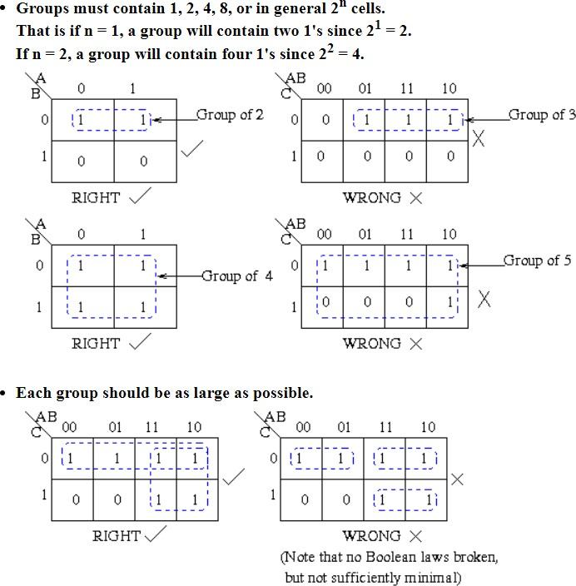
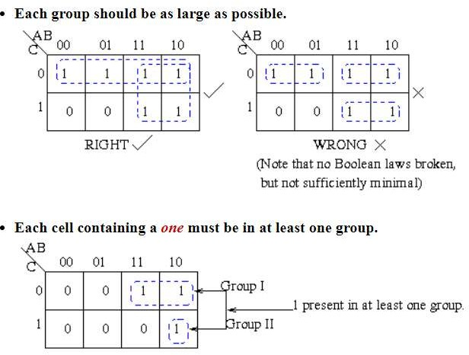

Slide 6
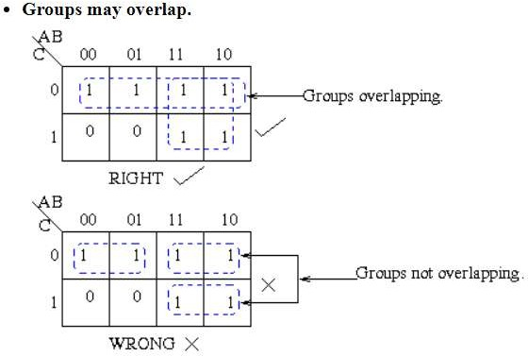
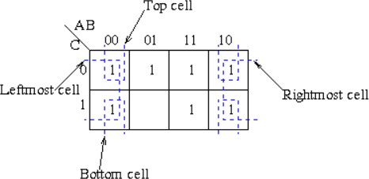
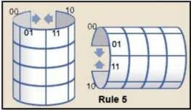
A square containing 1 should not be left alone to be included in the final expression if there is a possibility of its inclusion in a group of two squares containing 1s. Similarly, a group of two 1-squares (i.e. square containing 1) should not be made if these 1-square can be included in a group of four 1-squares and so on.
Groups may wrap around the table. The leftmost cell in a row may be grouped with the rightmost cell and the top cell in a column may be grouped with the bottom cell.

Slide 7
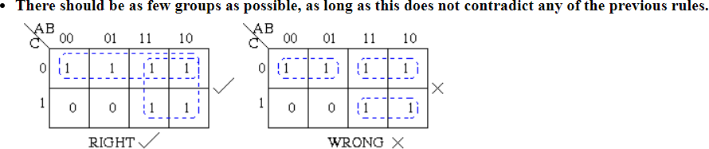

Slide 8
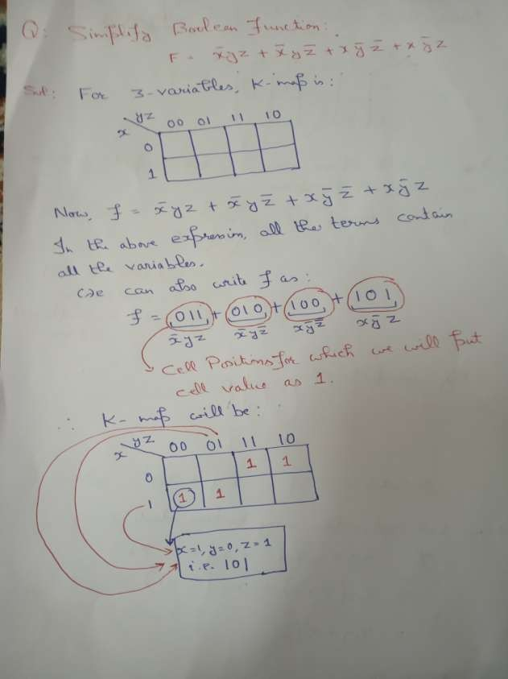

Slide 9
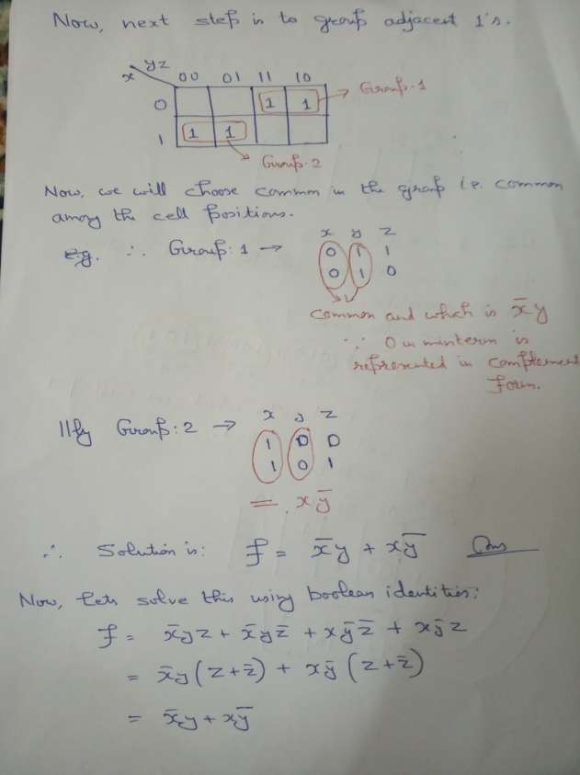

Slide 10
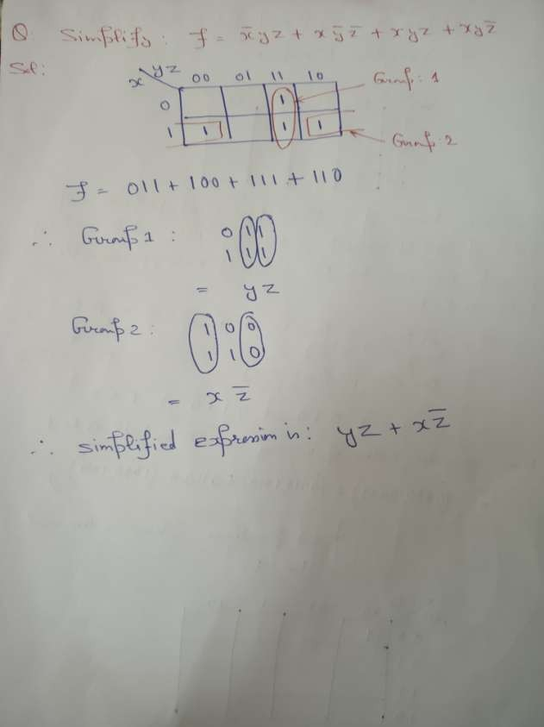

Slide 11
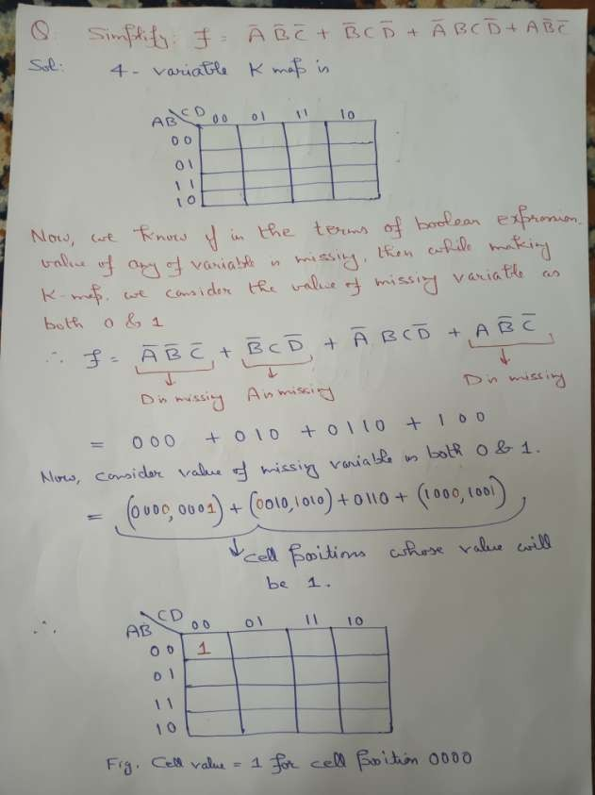

Slide 12
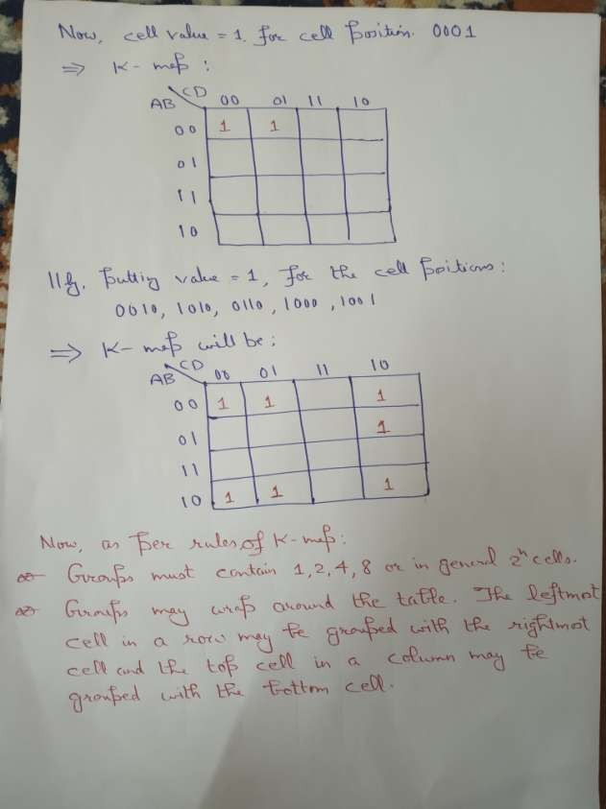

Slide 13
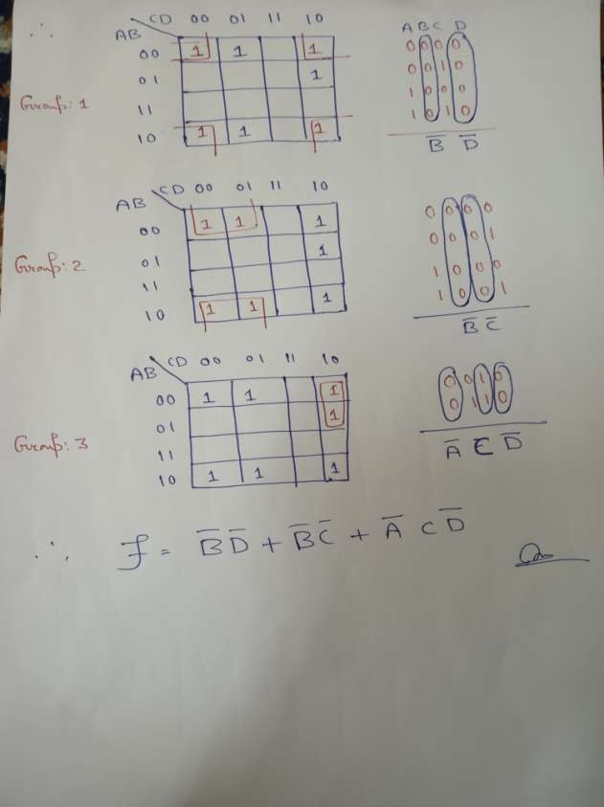

Slide 14
References :
[1]
Composed by David Belton http://www.ee.surrey.ac.uk/Projects/Labview/minimisation/karnaugh.html Eric Coates (Revision 14.01 18th July 2020)
https://learnabout-electronics.org/Digital/dig24.php
[2]

